Slide 1
Lecture 13 Decision Trees and Random Forest
El-GY 6143: Introduction to machine learning
Prof. Pei LIu

Slide 2
End of Semester Logistics
Final exam on Monday May 17, 11:00AM-1:30PM over Zoom
Will send Zoom link later this week by email
Same format as midterm
Please check all your homework grades by Sunday.
If there are any problems, talk with Ashutosh during next week’s office hours
Last homework (this lecture) will not be graded since solution will be posted
Final project (optional) due by next Friday
Submission via NYUClasses
Submit a quad chart, a brief report and .ipynd (both pdf and executable)

Slide 3
Outline
Decision tree as constrained space partition
Regression tree design
Decision tree pruning
Classification tree design
Bagging
Random Forest
Feature ranking from random forest

Slide 4
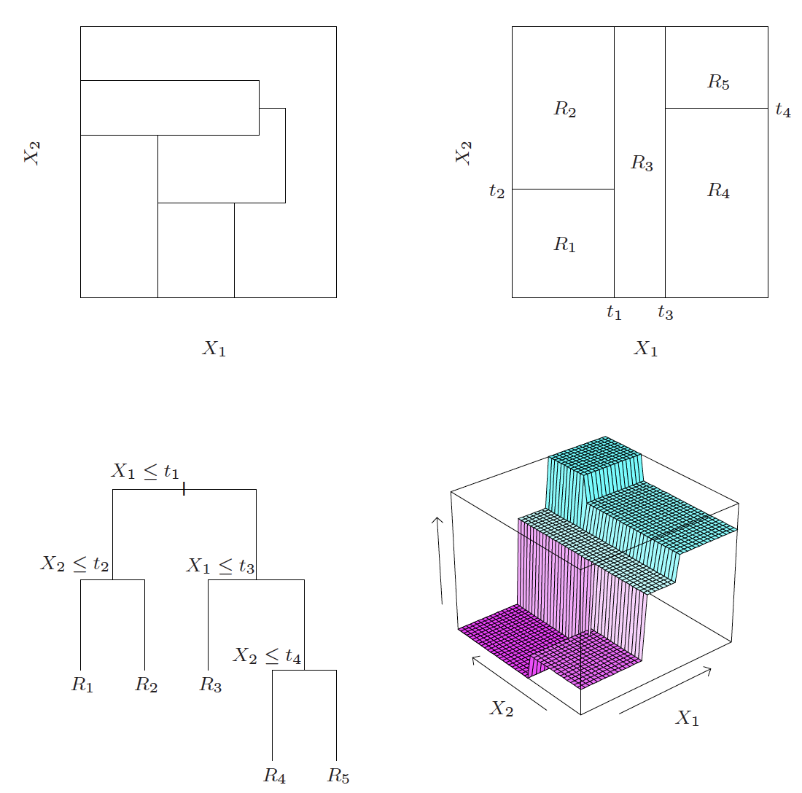
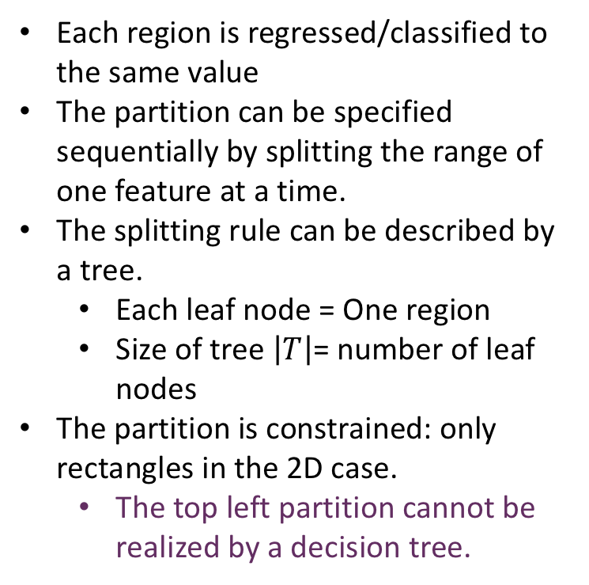
Decision tree as constrained space partitioning
Each region is regressed/classified to the same value
The partition can be specified sequentially by splitting the range of one feature at a time.
The splitting rule can be described by a tree.
Each leaf node = One region
Size of tree $\left|T\right|$= number of leaf nodes
The partition is constrained: only rectangles in the 2D case.
The top left partition cannot be realized by a decision tree.
Fig. 9.2 in ESL

Slide 5
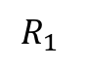
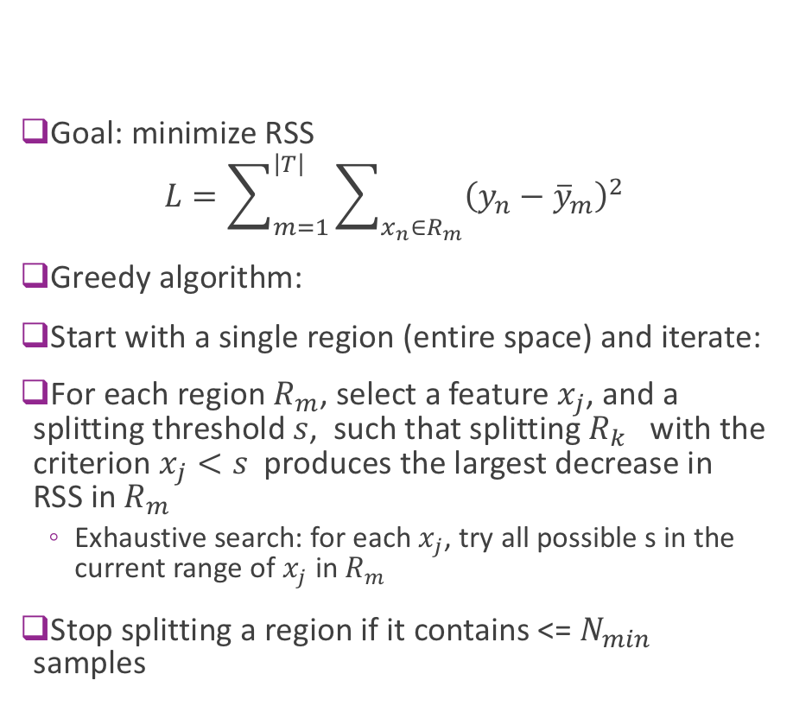
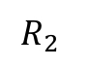
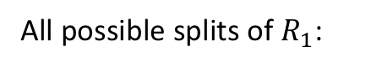
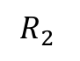
How to build a decision tree? (Regression Case)
Goal: minimize RSS
$$L=\sum_{m=1}^{\left|T\right|}{\sum_{x_{n}∈R_{m}}{{\left(y_{n}−{\overline{y}}_{m}\right)}^{2}}}$$
Greedy algorithm:
Start with a single region (entire space) and iterate:
For each region $R_{m}$, select a feature $x_{j}$, and a splitting threshold $s$, such that splitting $R_{k}$ with the criterion $x_{j}<s$ produces the largest decrease in RSS in $R_{m}$
Exhaustive search: for each $x_{j}$, try all possible s in the current range of $x_{j}$ in $R_{m}$
Stop splitting a region if it contains <= $N_{min}$ samples
$$R_{1}$$
$$R_{2}$$
All possible splits of $R_{1}$:
$$R_{2}$$

Slide 6
Overfitting
Decision tree is very prone to overfitting
Can exactly represent any function defined by the training set by having as many regions (or leaf nodes) as needed (Fully grown tree)
How to control overfitting?
Find optimal subtree (with a certain constraint on the minimum number of samples in the leaf nodes or maximum depth) by cross validation: too many possibilities
Stop growing once RSS stop decreasing by a threshold with any new cut:
Not good because we use greedy search. It is possible to find a good cut after a bad one.
Better idea: grow a full tree first, then prune the tree.

Slide 7
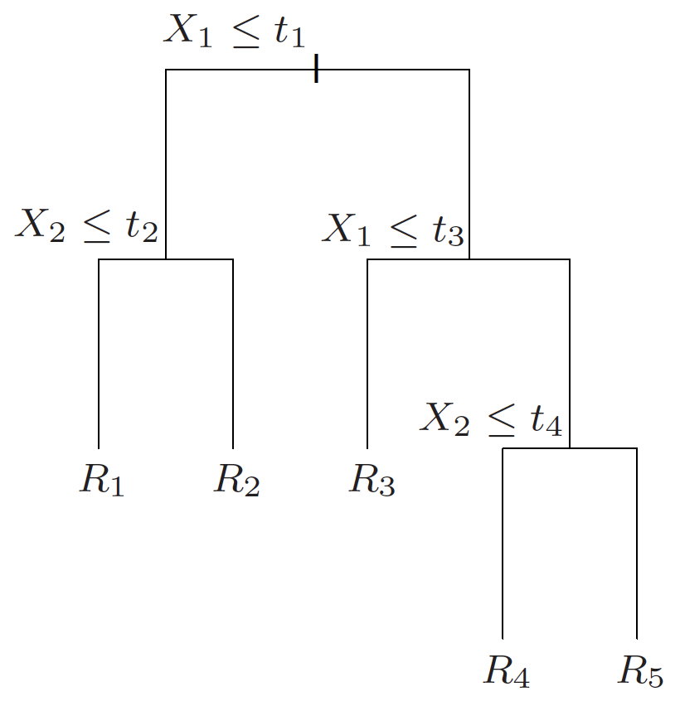
Weakest link pruning
Starting with with the initial full tree T0 , merge two adjacent leave nodes (daughter nodes) to a single leaf node (mother). Select which nodes to merge by minimizing error increase. This produces a tree with one less region (or node)
Repeat to merge another two nodes, until the minimum size tree is reached (e.g. a stump with 2 nodes)
Generate a sequence of trees
T0, T1, T2, T3, …
Which one to choose?

Slide 8
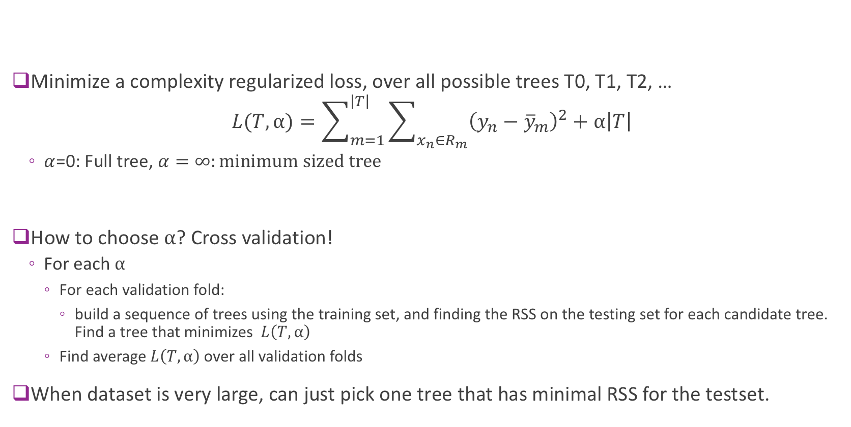
Cost complexity pruning
Minimize a complexity regularized loss, over all possible trees T0, T1, T2, …
$$L(T,α)=\sum_{m=1}^{\left|T\right|}{\sum_{x_{n}∈R_{m}}{{\left(y_{n}−{\overline{y}}_{m}\right)}^{2}}}+α\left|T\right|$$
$α$=0: Full tree, $α=∞:minimum sized tree$
How to choose $α$? Cross validation!
For each $α$
For each validation fold:
build a sequence of trees using the training set, and finding the RSS on the testing set for each candidate tree. Find a tree that minimizes $L\left(T,α\right)$
Find average $L\left(T,α\right)$ over all validation folds
When dataset is very large, can just pick one tree that has minimal RSS for the testset.
Number of leaf nodes (regions)

Slide 9
Example: Predicting baseball player salaries
From http://web.stanford.edu/class/stats202/notes/Tree/Regression-trees.html

Slide 10
Feature importance
For each feature, find all splits where this feature was used as the split variable and add up the loss reduction at all such splits
The sum reflects the importance of this feature!

Slide 11
Demo: weather prediction using decision tree

Slide 12
What about classification?
The predicted class for each region = the majority class of training samples in the region
How to design the tree?
Can use the same greedy algorithm
Split each region (by picking a feature and a threshold) to minimize a loss
What loss functions to use?

Slide 13
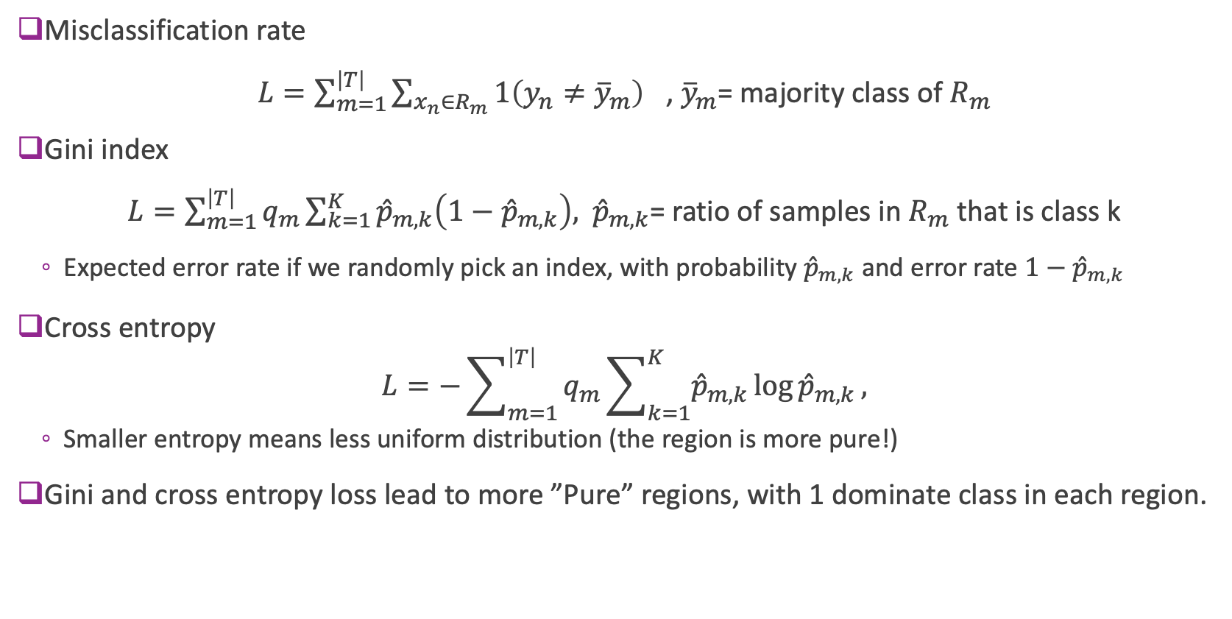
Classification loss
Misclassification rate
$L=\sum_{m=1}^{\left|T\right|}{\sum_{x_{n}∈R_{m}}{{1\left(y_{n}≠{\overline{y}}_{m}\right)}^{}}}$, ${\overline{y}}_{m}$= majority class of $R_{m}$
Gini index
$L=\sum_{m=1}^{\left|T\right|}{q_{m}\sum_{k=1}^{K}{{\hat{p}}_{m,k}\left(1−{\hat{p}}_{m,k}\right), }}$ ${\hat{p}}_{m,k}$= ratio of samples in $R_{m}$ that is class k
Expected error rate if we randomly pick an index, with probability ${\hat{p}}_{m,k}$ and error rate $1−{\hat{p}}_{m,k}$
Cross entropy
$$L=−\sum_{m=1}^{\left|T\right|}{q_{m}\sum_{k=1}^{K}{{\hat{p}}_{m,k}\log{{\hat{p}}_{m,k}}, }}$$
Smaller entropy means less uniform distribution (the region is more pure!)
Gini and cross entropy loss lead to more ”Pure” regions, with 1 dominate class in each region.

Slide 14
Performance metric and pruning
After a tree is designed, the performance is still measured by the misclassification rate or accuracy
It is typical to use the Gini index or cross entropy when growing a tree, but use the misclassification rate for pruning a tree

Slide 15
Example: Classifying heart disease
From http://web.stanford.edu/class/stats202/notes/Tree/Classification-trees.html

Slide 16
Advantage of decision tree
Easy to interpret: Doctors like them
Closer to human decision making
Feature importance can be derived during training
Can easily handle mixed type of features (numerical and categorical) and missing features in some samples
Did not discuss here
Problem:
To reduce bias, needs to grow the tree deeper
Deeper trees tend to overfit the training data (Large variance among different training data)
How to overcome ?

Slide 17
Bagging (Bootstrap Aggregating)
Idea: Generate multiple trees from different training sets, and apply all models to each test sample and take average (or majority) of the results from all the trees
How to generate different training sets giving a dataset?
Cross validation: using a subset of data each time for training and the remaining for testing
Bootstrap sampling: Sampling by replacement, each sampling contains the same number of samples as the original dataset, but some samples are replicated, others were not included
Bagging: Generate B models from B bootstrap samplings
Regression: Average the prediction results from B models
Classification: Take the majority class index
Apply to other regressors/classifiers as well.

Slide 18
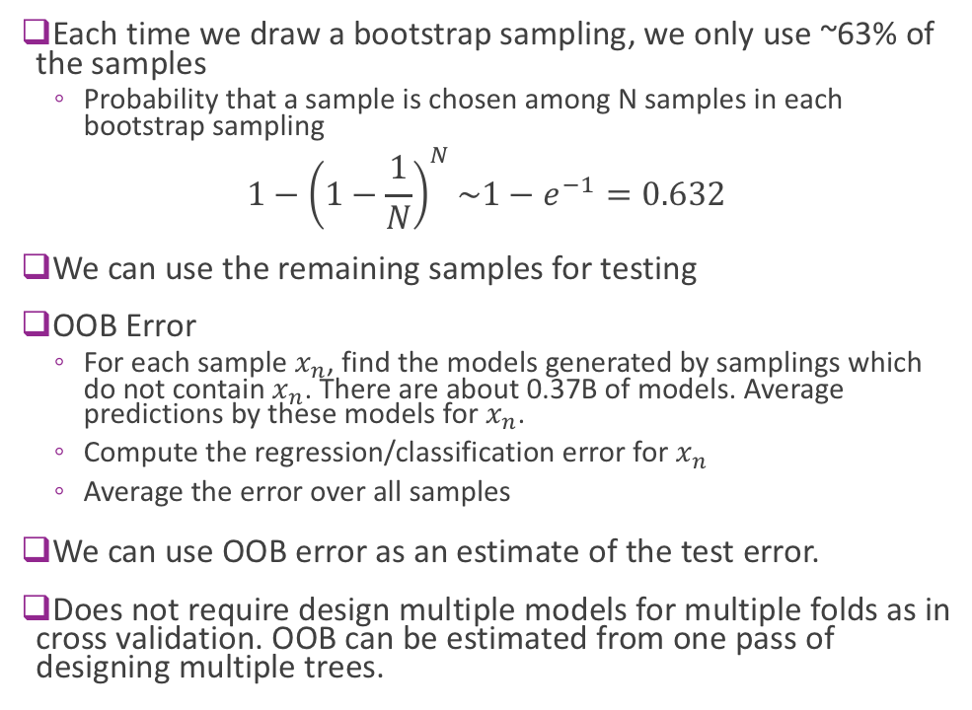
Out of bag (OOB) error
Each time we draw a bootstrap sampling, we only use ~63% of the samples
Probability that a sample is chosen among N samples in each bootstrap sampling
$${1−\left(1−\frac{1}{N}\right)}^{N}\sim 1−e^{−1}=0.632$$
We can use the remaining samples for testing
OOB Error
For each sample $x_{n}$, find the models generated by samplings which do not contain $x_{n}$. There are about 0.37B of models. Average predictions by these models for $x_{n}$.
Compute the regression/classification error for $x_{n}$
Average the error over all samples
We can use OOB error as an estimate of the test error.
Does not require design multiple models for multiple folds as in cross validation. OOB can be estimated from one pass of designing multiple trees.
From ESL Fig. 15.4

Slide 19
Why bagging?
When a regressor or classifier has tendency to overfit (i.e. sensitive to the training set), bagging reduces the variance of the prediction
Reduce the test error
Particularly useful for decision trees
When the sample number N in a given dataset is large
The empirical distribution is similar to the true distribution
Each bootstrap sampling is similar to an independent realization of the true distribution
Bagging amounts to averaging the fits from many identically distributed datasets

Slide 20
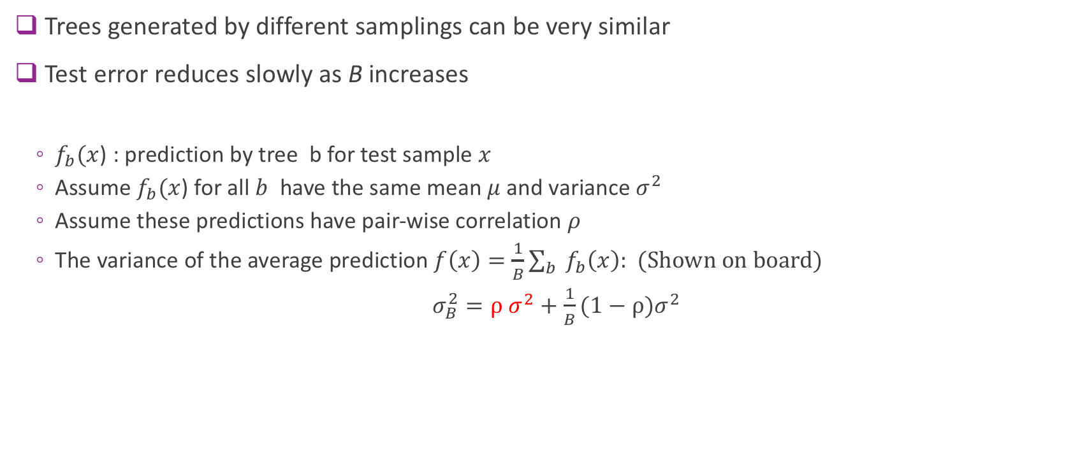
Problems with bagging?
Trees generated by different samplings can be very similar
Test error reduces slowly as B increases
$f_{b}(x$) : prediction by tree b for test sample $x$
Assume $f_{b}(x$) for all $b$ have the same mean $μ$and variance $σ^{2}$
Assume these predictions have pair-wise correlation $ρ$
The variance of the average prediction $f\left(x\right)=\frac{1}{B}\sum_{b}{f_{b}\left(x\right):}$ (Shown on board)
$σ_{B}^{2}=ρ σ^{2}+$ $\frac{1}{B}(1−ρ)σ^{2}$

Slide 21
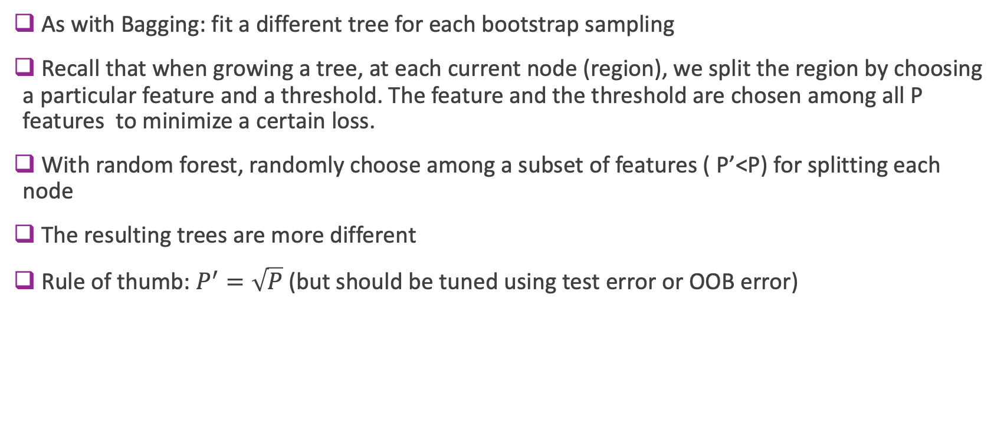
Random Forest
As with Bagging: fit a different tree for each bootstrap sampling
Recall that when growing a tree, at each current node (region), we split the region by choosing a particular feature and a threshold. The feature and the threshold are chosen among all P features to minimize a certain loss.
With random forest, randomly choose among a subset of features ( P’<P) for splitting each node
The resulting trees are more different
Rule of thumb: $P^{′}=\sqrt{P}$ (but should be tuned using test error or OOB error)

Slide 22
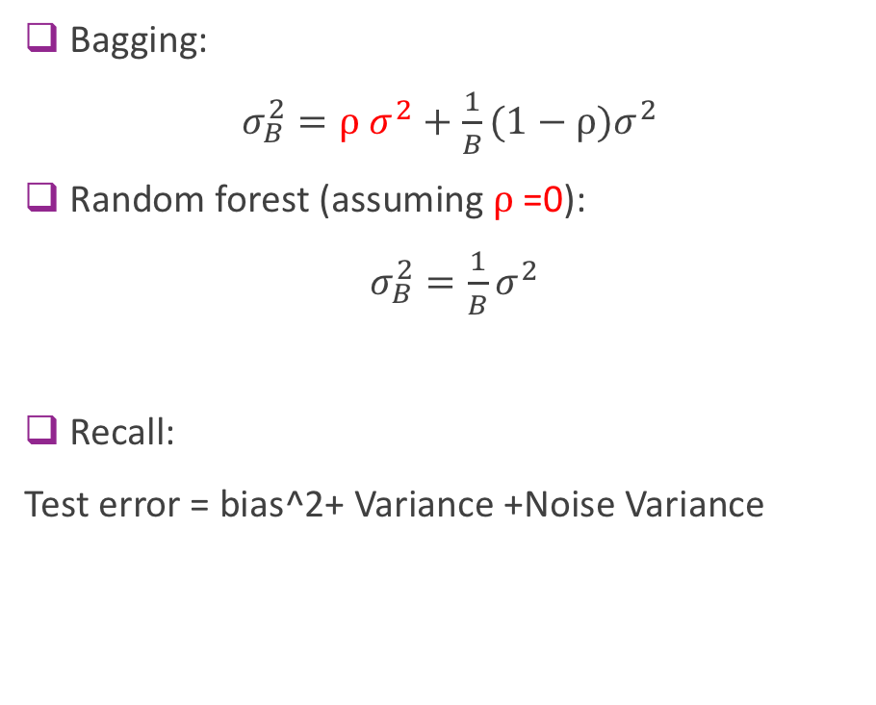
Bagging vs. RF
Bagging:
$σ_{B}^{2}=ρ σ^{2}+$ $\frac{1}{B}(1−ρ)σ^{2}$
Random forest (assuming $ρ$=0):
$σ_{B}^{2}=\frac{1}{B}σ^{2}$
Recall:
Test error = bias^2+ Variance +Noise Variance
From ESL, Fig. 15.1

Slide 23
Feature importance
For each feature, add up the loss reduction at splits where this feature was used over all trees.

Slide 24
Demo: Random forest

Slide 25
Problem with bagging and random forest
Resulting model has many trees!
Lose interpretability!
Related methods (not covered):
Boosting
Gradient boosting

Slide 26
What you should know from this lecture
How to use/interpret decision tree ?
How to train a decision tree ?
Loss function for regression
Loss function for classification
How to reduce overfitting ?
What does bagging mean ?
How to train and use a random forest ?
How to determine feature importance?

Slide 27
References
[ESL] Hastie, T., & Tibshirani, R. & Friedman, J.(2008). The Elements of Statistical Learning; Data Mining, Inference and Prediction. Sec. 9. (Decision tree), Sec. 15.2 (Random forest)

